Slide 1
L6 Group 6: IceBreaker
Samuel Cook
Anthony Brame
Robert Yearling
William Terry

Slide 2
Logline:
Explore an ship as Birch Unravelling a dark secret held deep in the belly of the IceBreaker.

Slide 3
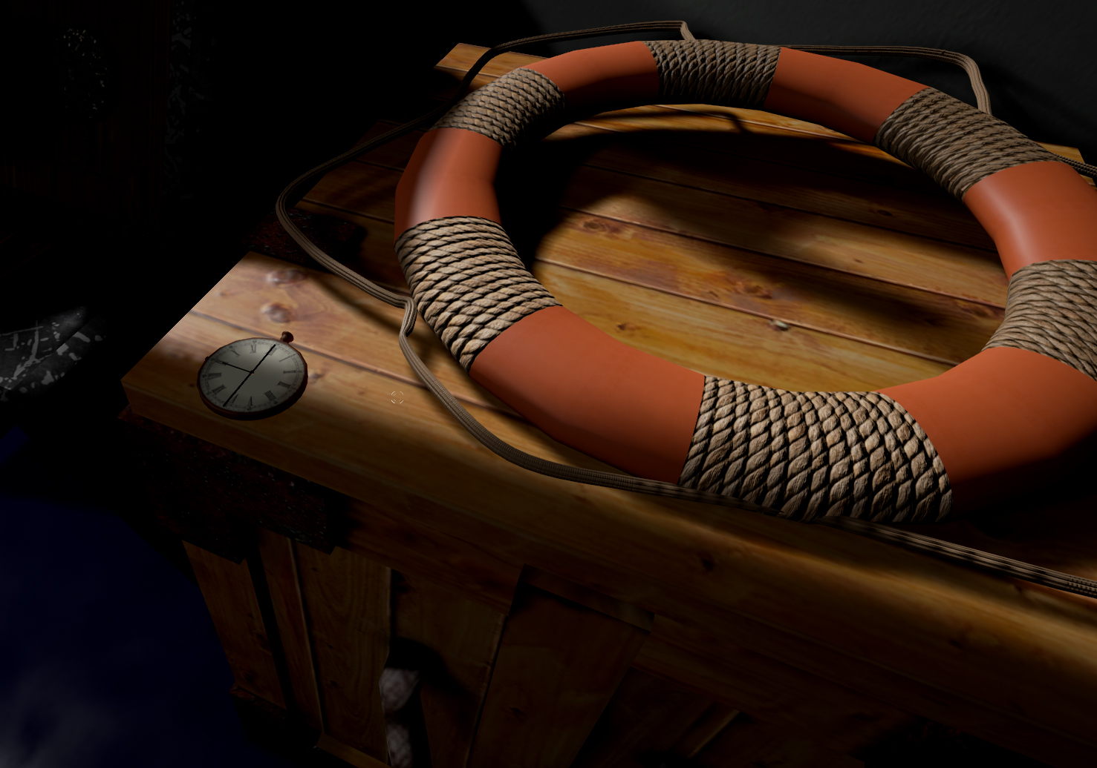

Slide 4
Demographic
Gender: Males
Age: 18 – 24 (Schell J, 2008)
Type of player: Explorer (Bartle R, 1996)

Slide 5
Concept:
Theme: Fantasy horror Steam era 1920's
Story: Icebreaker Heading home from an arctic expedition to bring word of the discovery of an artifact, however will they make it home and if they do what will they unleash upon the world.
Entertainment though Atmosphere (Horror)
Entertainment though Thrills (Suspense)
(Phillips and Huntley, 2004)

Slide 6
Unique Selling Points
Minimal use of non diegetic elements
Voice used to convey objectives (intercom)
Pocket watch system for player navigation and audio recording for in-game lore.

Slide 7


Slide 9
Progress
Focus:
Underlying systems/tools iteration
3D Art asset creation
Enemy behavior blueprint creation
Audio asset creation
Scripted our introduction to the game mechanics

Slide 10
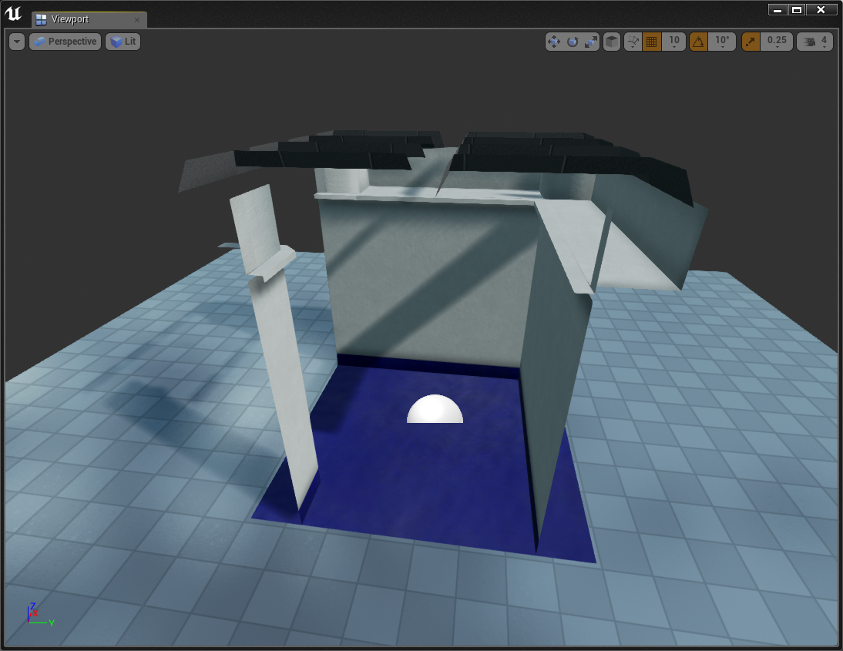
Blueprints
Modular tile system (similar to fallout 4)
Quickly lay out levels and iterate
Design freedom
Looking at Steam Watch
Intractable objects:
Levers (Puzzles)
Doors (Slow opening)

Slide 11
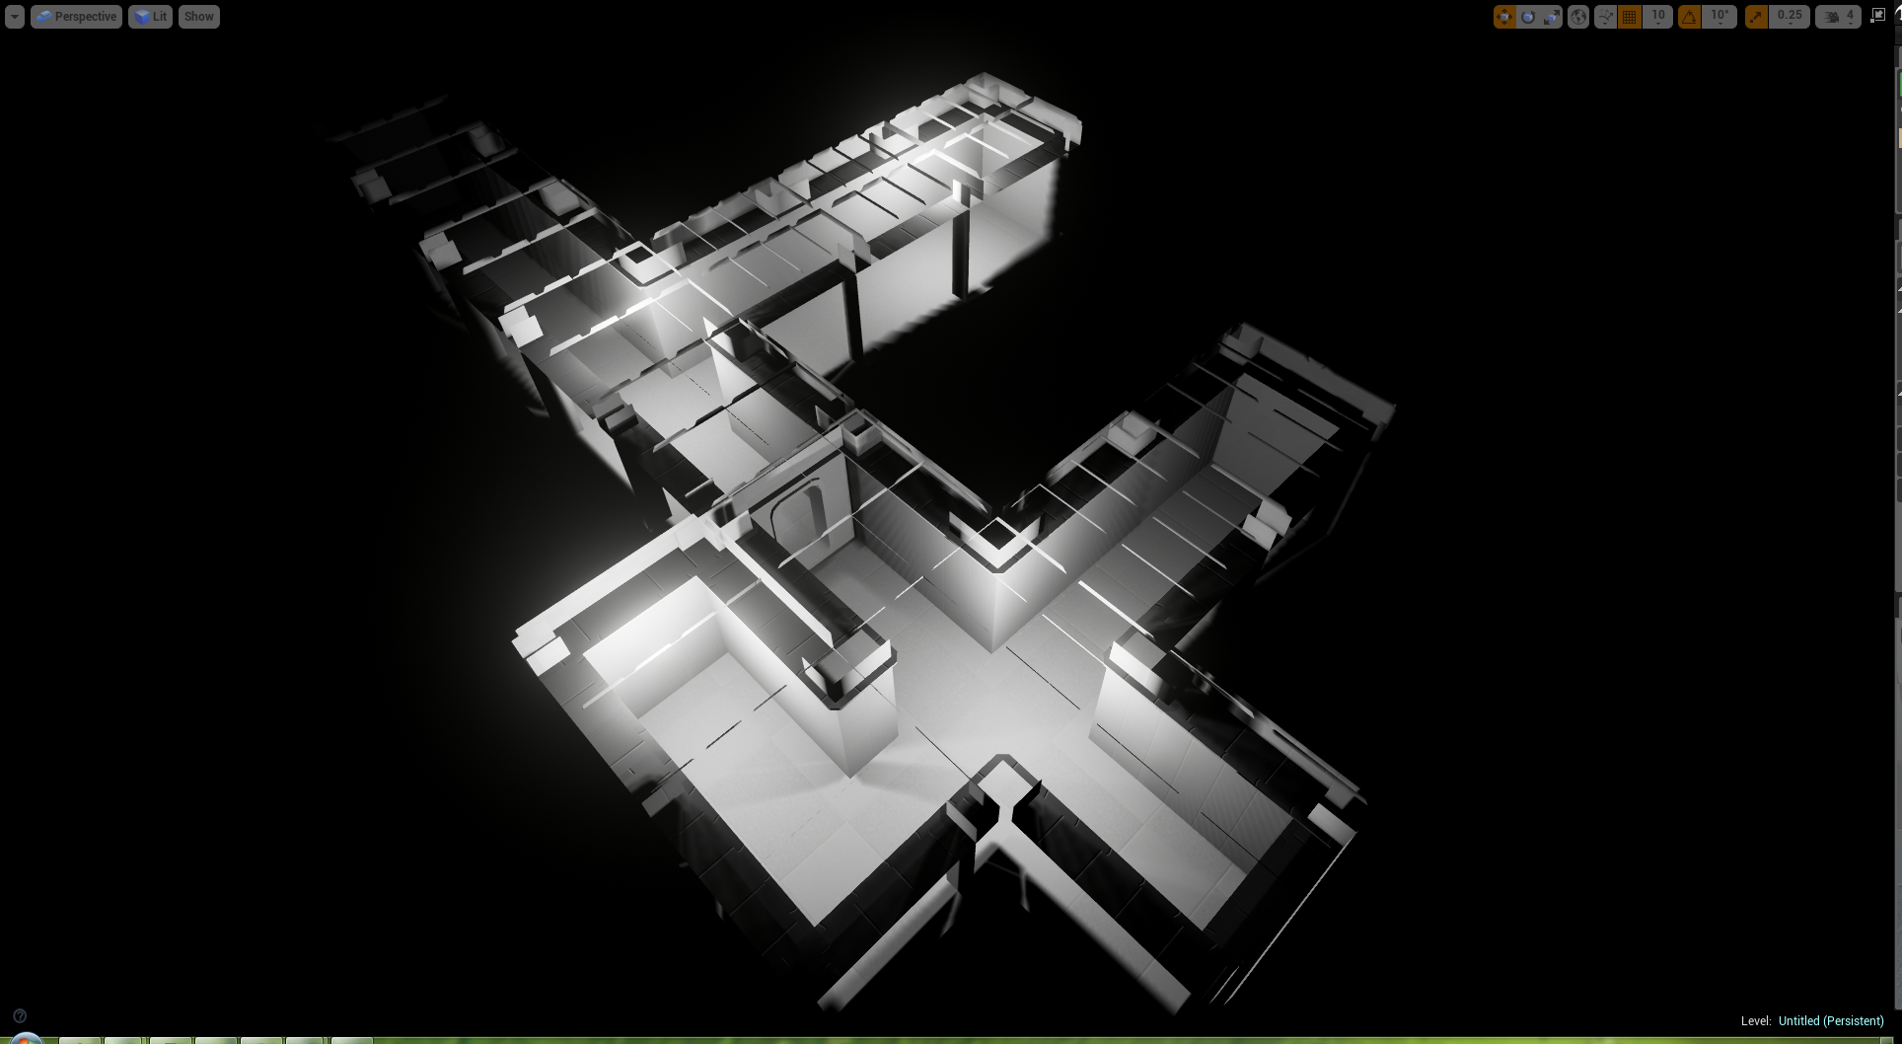

Slide 12
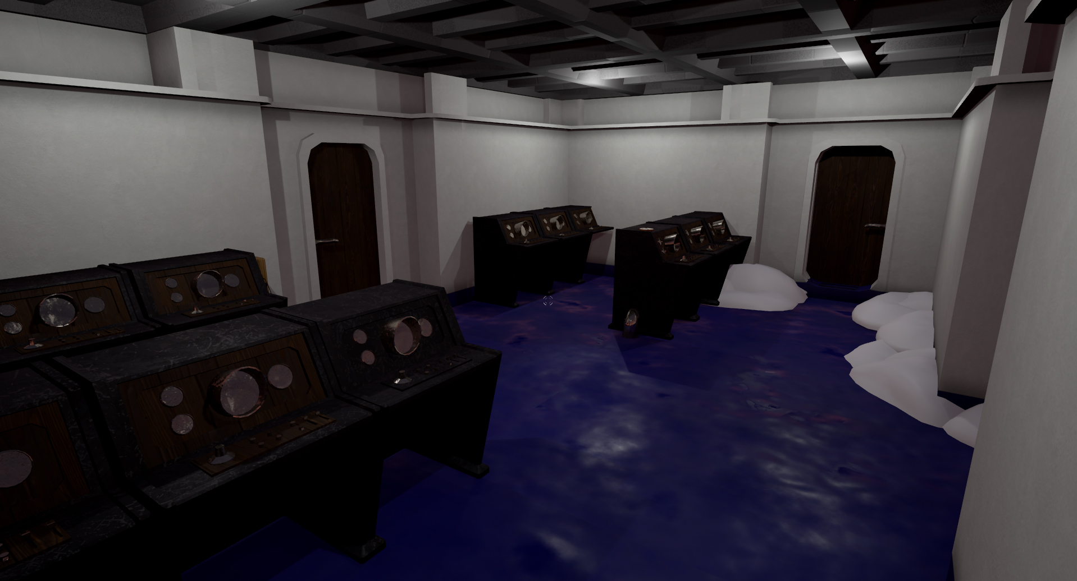

Slide 13
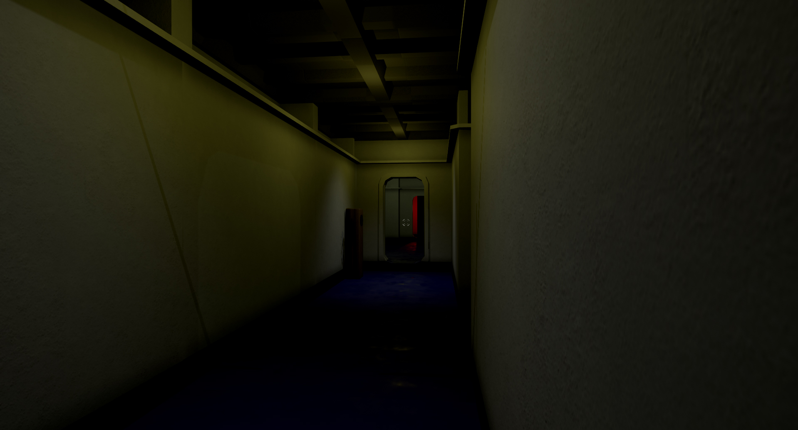

Slide 14
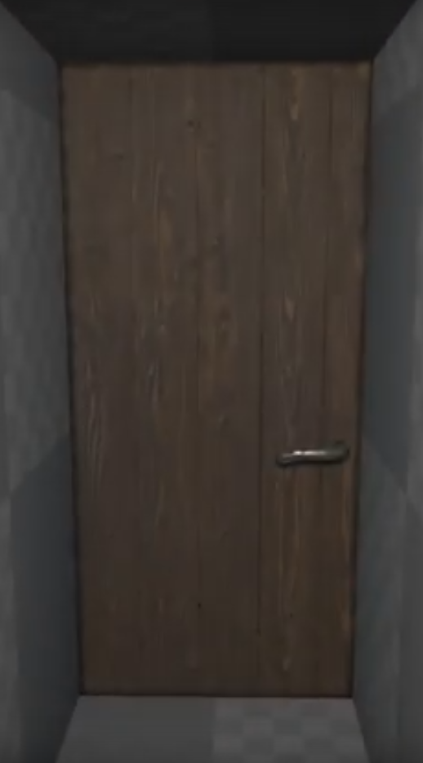
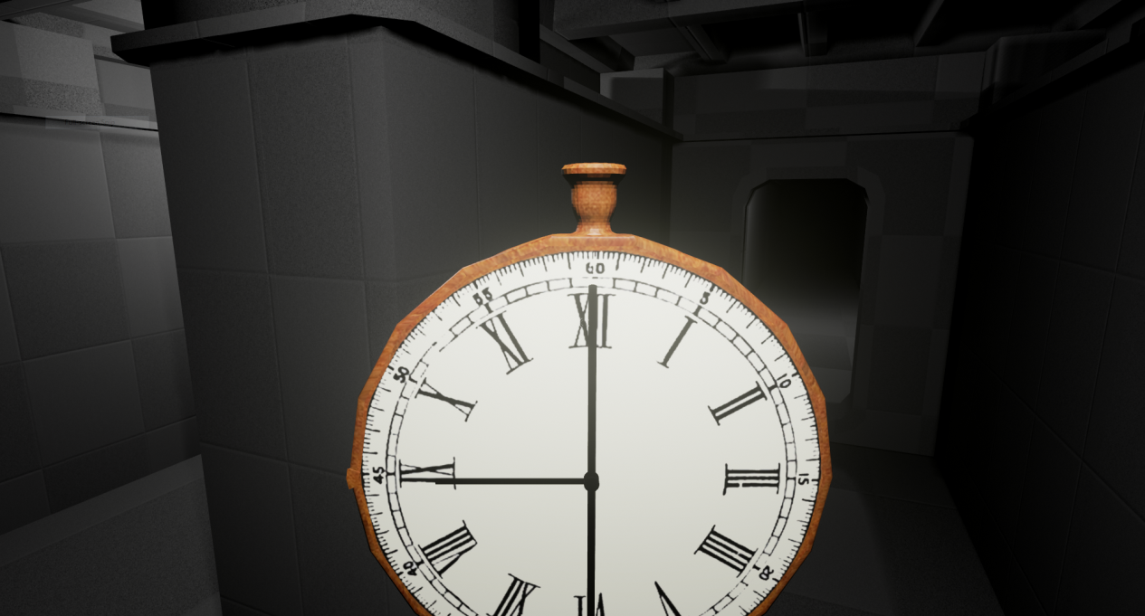
Art Assets
Models for Chapter 1
Ship's Bridge
Ship interior Tile set

Slide 15
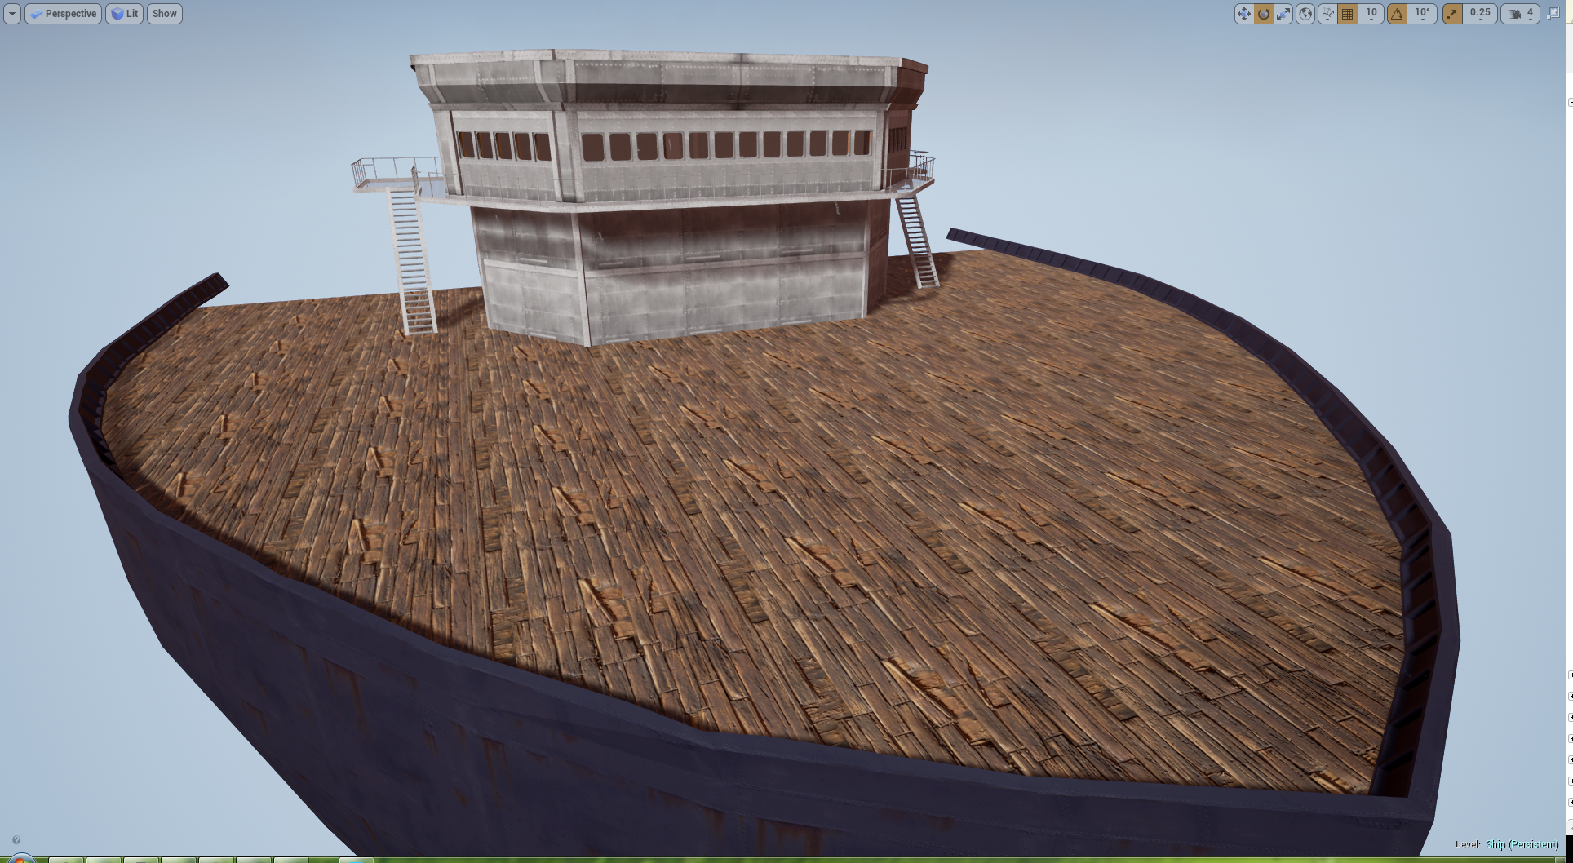

Slide 16
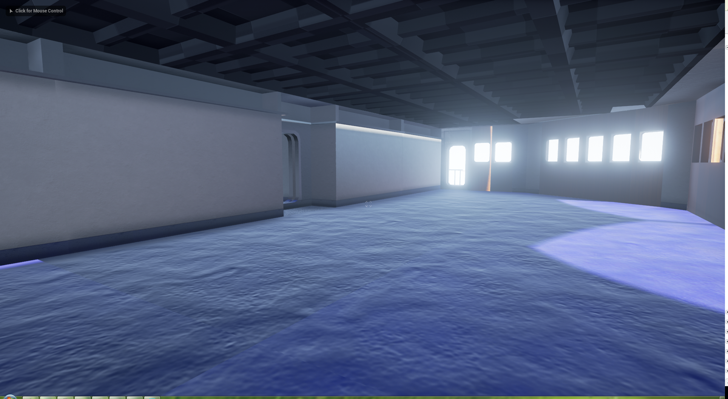

Slide 17
Management:
The transition from GitHub to Jira has increased the level of engagement with the project, it has also from a managers perspective allowed me to track how much work as been done at specific times in the sprint with logged time.
Communication has been good and the team are consistent at attending meetings.
GitHub 64 closed issues.
Jira

Slide 18
Thank you for listening , Any Questions?
References
Bartle, R. (1996) Richard A. Bartle: Players Who Suit MUDs, Mud.co.uk. Available at: http://mud.co.uk/richard/hcds.htm (Accessed: 17 October 2016).
Phillips, M. and Huntley, C. (2004) Dramatica. Glendale, Calif.: Write Brothers Press.
Schell, J. (2008) The art of game design. Amsterdam: Elsevier/Morgan Kaufmann.

